Slide 1
MASTER OF TECHNOLOGY:
PHASE 3 PRESENTATION
[January 2012]
SE18 – Team 2S
Tran Ba Tien
Alvin Chang Parkk Khiong
Maung Tin Kyaw Oo
Roger Koh Ming Jin
Phyo Phyo Lwin
Junaith

Slide 2
Overview
Introduction
Development Strategy (UCMS and Soft Architecture)
Technical Challenges
System Demo (video)
Acceptance Process (planned)
Project Progress Against Plans (man-days and schedule)
Management Problem
Recommendations for further work
Lessons learnt

Slide 3
Introduction
Client:
  Name: Hoang Kim (Golden Gravure) Joint Stock Co.
  One of the leading providers of printing cylinders in Vietnam
What they have
    Around 80 Desktops
    Current system running on 1 server, running Win 2003, MySQL database
    Current system (3 thick clients) running on VB.NET
What they want
    1 integrated system to manage process / employee data (sales orders, cylinders, employee, roles, workflows)
    To generate reports for management (cylinder statistics, employee statistics)
    Real time system

Slide 4
Development Strategy
Waterfall SDLC
Requirements Gathering → High-level Design → Detailed Design → Implementation → System Integration Test → User Trial
Design Approach:
  .NET Web Application running in Windows Server
  MVC approach
    Model: .NET Entity Framework
    View: ASP .NET classes
    Controller: C# .NET classes
  C# .NET thick client (for diagram drawing functions)

Slide 5
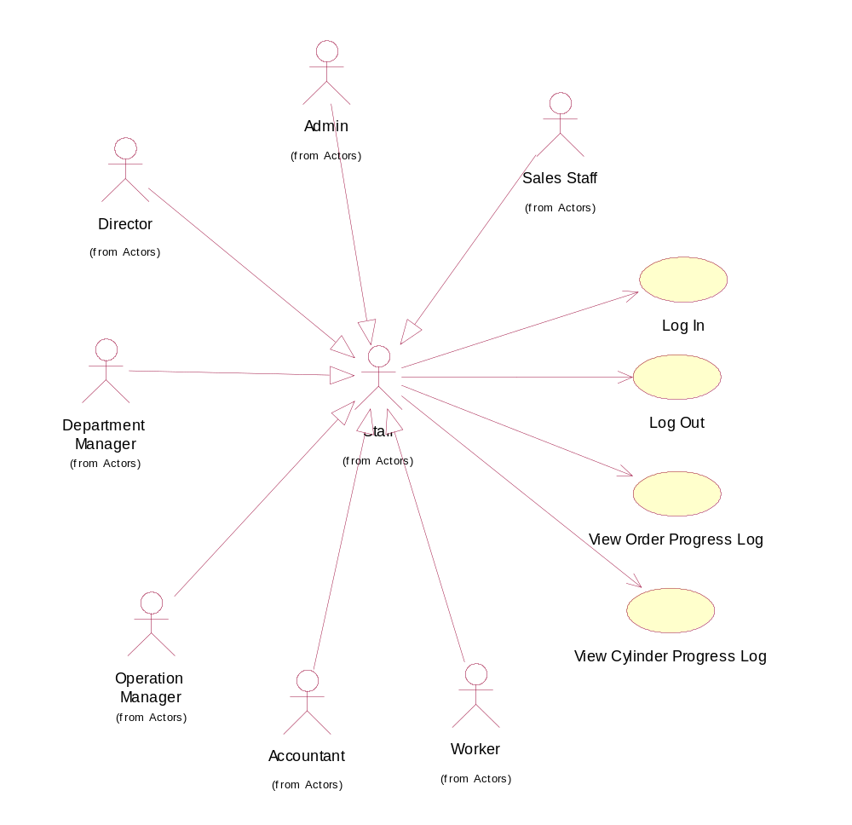
Use Case Modeling

Slide 6
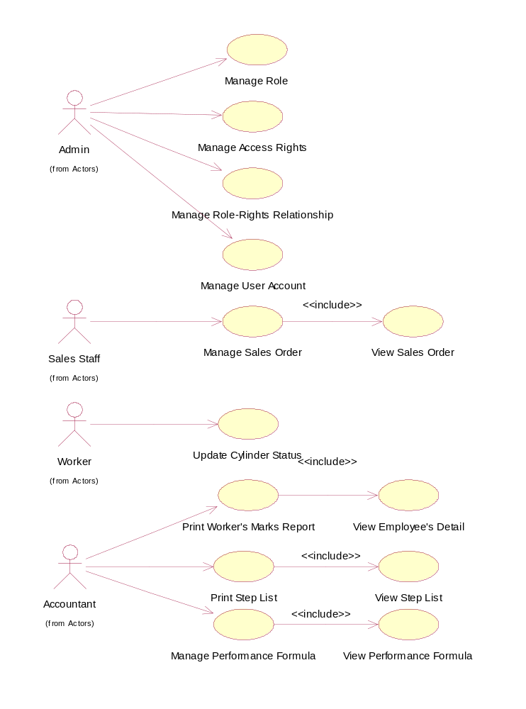
Use Case Modeling (2)

Slide 7
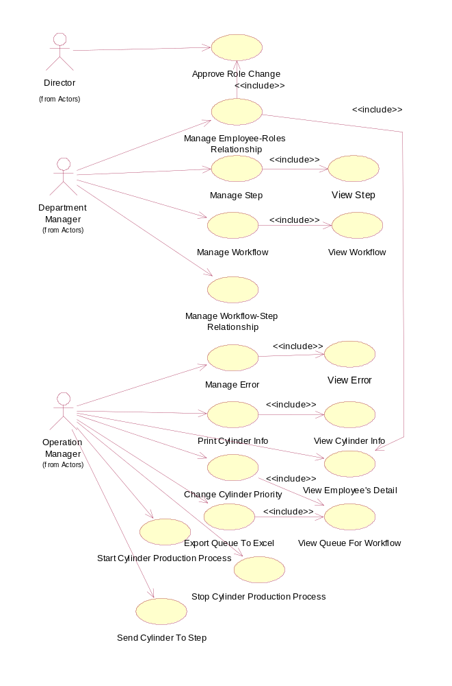
Use Case Modeling (3)

Slide 8
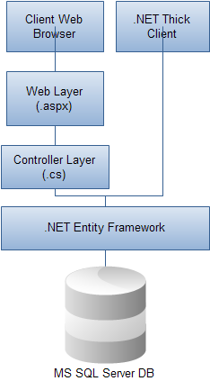
Software Architecture

Slide 9
Technical Challenges
Get used to .NET Framework
  ASP. NET and C# .NET
  Visual Studio IDE
  SQL Server Management Studio
Get used to SVN for Configuration Management

Slide 10
System Demo (video)

Slide 11
Acceptance Process (planned)
System Demo done with client
Acceptance Proof obtained
Data Migration planned in February

Slide 12
Overall Project Progress
Phase | Design Modeling | Programming | System Integration Test
Planned MD | 43 | 47 | 30
Actual MD | 45 | 50 | 40
Planned Schedule | End 2/8/11 | End 20/9/11 | End 25/10/11
Actual Schedule | End 31/8/11 | End 14/12/11 | End 11/1/12

Slide 13
Re-Planning
Re-allocate tasks to members with more experiences
Data Migration pushed to February

Slide 14
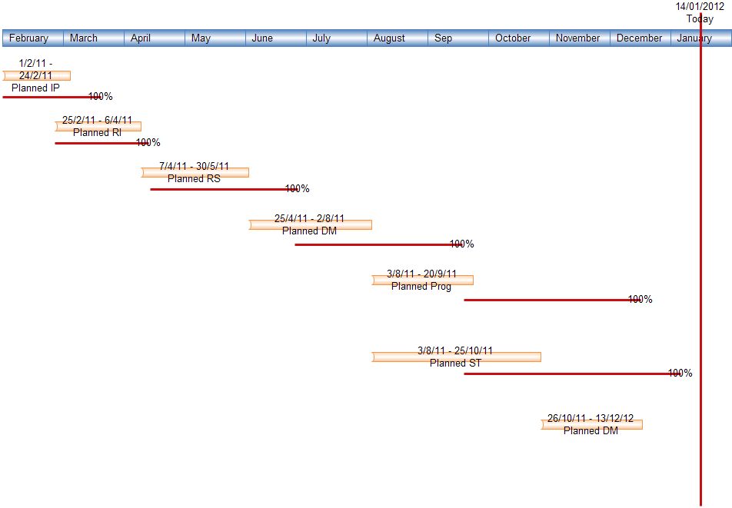
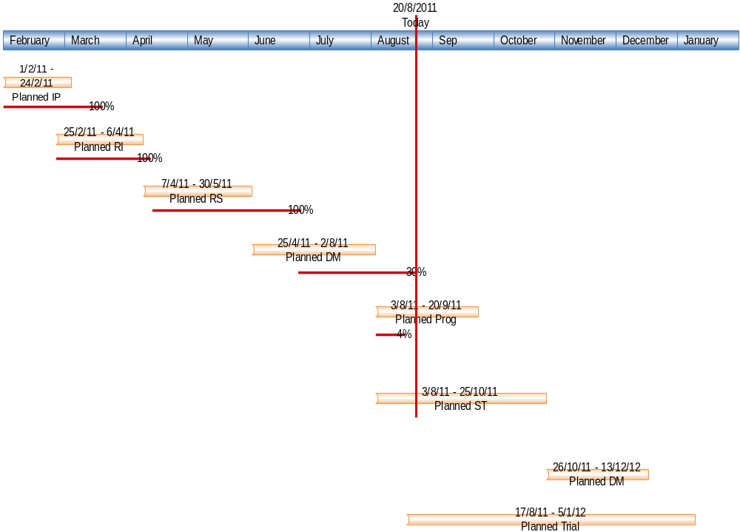

Slide 15
Management Problems
School assignments and exams causes project man-days to be reduced
2 team member got married in September and October → available man-days are reduced
Several team members are dealing with heavy workload and OTs at the workplace

Slide 16
Management Problem - Solutions
Re-plan Data Migration to Feb 2012
Re-assign tasks to personnels with more experiences
Track member work tasks and issues by sharing Google docs for faster turn-around time

Slide 17
Recommendations for further work
There might be Change Requests from user
Use appropriate change request procedure to handle
Monitor actual usage and study usability for future enhancements

Slide 18
Lessons Learnt
Planning should include more buffers to be able to handle manpower, schedule problems.
Defects detected earlier in the process are less costly than those detected later
Regular tracking is important to keep project on schedule
Software designs should not just fulfill requirements but also target flexibility, usability and maintainability (learnt from legacy systems at user side).

Slide 19
Q&A
Thank you

